Slide 1

Chapter 5
Data Collection and Analysis in Science with Computational Tools
From Raw Data to Meaningful Insights
Computing Science for Science Teaching
วิทยาศาสตร์คอมพิวเตอร์สำหรับการสอนวิทยาศาสตร์
Author
Dr. [Author Name]
Affiliation
[Institution Name]

Slide 2

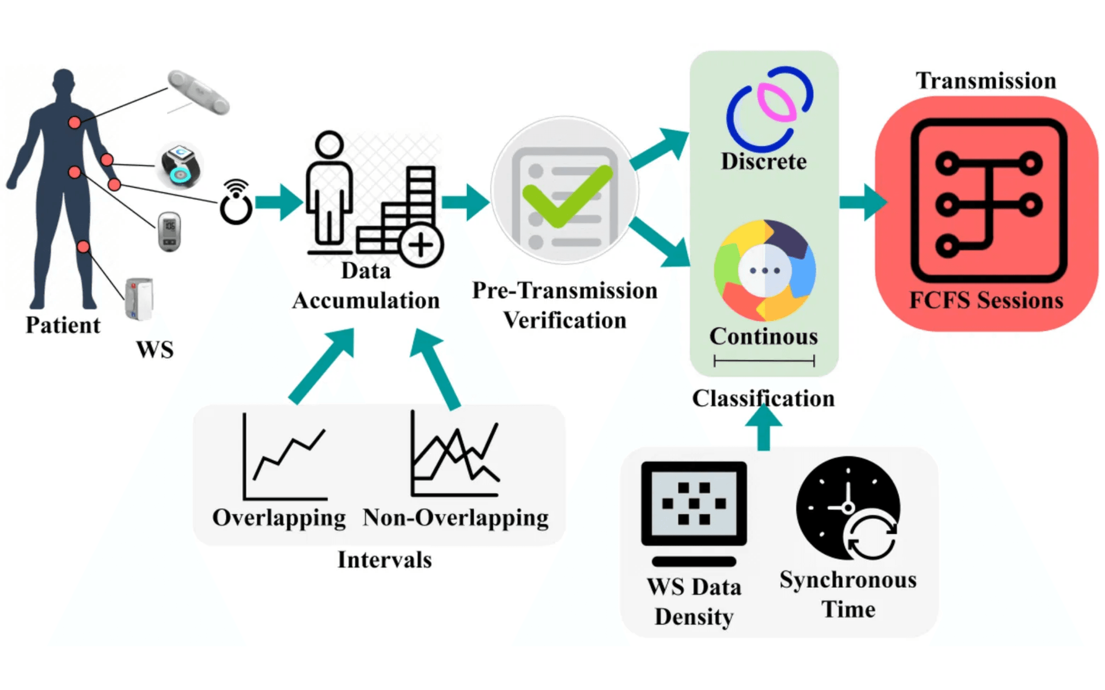
The Role of Data in Modern Science
Data is the foundation of scientific discovery. Modern science increasingly relies on data-driven approaches, where careful observation and measurement generate the evidence that supports or refutes scientific hypotheses.
▸
Digital Tools Enable Vast Data Collection:
Sensors and automated systems capture millions of measurements, generating datasets far larger than traditional manual methods could produce.
▸
Real-Time Data Collection:
Modern instruments provide immediate feedback, allowing scientists to monitor experiments continuously and respond dynamically to results.
▸
Data Reveals Hidden Patterns:
Computational analysis uncovers relationships and trends that would be invisible to human observation alone.
▸
Computational Tools are Essential:
Processing, analyzing, and visualizing large datasets requires computational power and specialized software.
Key Insight
Data collection and analysis are no longer optional skills for science educators—they are fundamental competencies that define contemporary scientific practice.

Slide 3

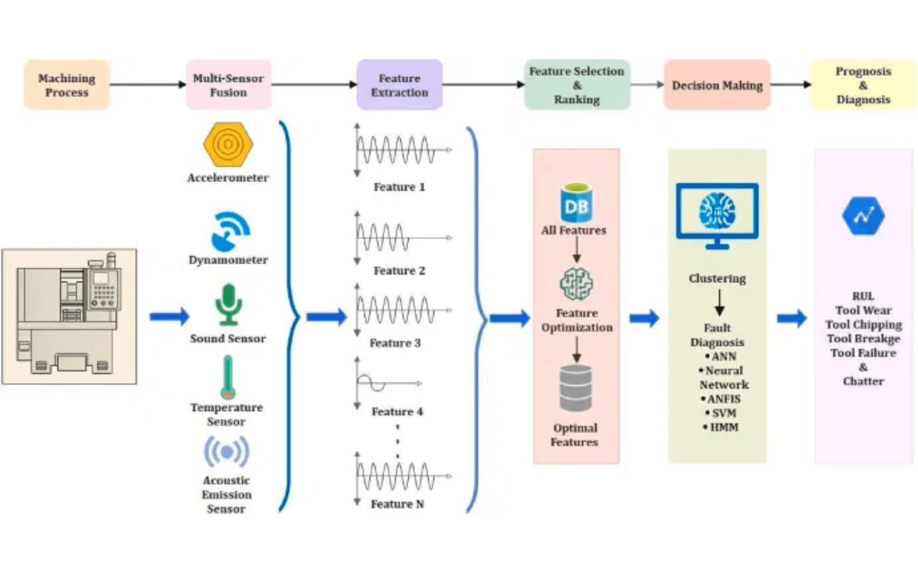
Digital Data Collection in Science Experiments
Sensors are devices that detect and respond to physical and chemical changes, converting them into electrical signals that computers can process and store.
Common Sensor Types:
Temperature:
Thermistors, thermocouples
pH:
Electrodes for acidity/alkalinity
Light:
Photodiodes, photoresistors
Motion:
Accelerometers, gyroscopes
Gas Concentration:
Chemical sensors
Data Acquisition System (DAS) Components
Sensors:
Measure physical quantities
Transducers:
Convert physical quantities to electrical signals
Signal Conditioners:
Amplify, filter, or modify signals
ADCs:
Convert analog signals to digital data
Data Logger:
Store and timestamp measurements

Slide 4

Types of Sensors and Their Applications
Sensors are specialized devices designed to measure specific physical or chemical properties. Different scientific applications require different sensors, each optimized for particular measurement ranges and environmental conditions.
Sensor Type 1
Sensor Type 2
Temperature Sensors
pH Sensors
Examples
Examples
Thermistors, thermocouples, RTDs
Glass electrodes, ISEs
Range
Range
-50°C to +200°C
0-14 pH scale
Applications
Applications
Weather monitoring, lab experiments, process control
Water quality, soil analysis, biochemical research
Sensor Type 3
Sensor Type 4
Light Sensors
Motion Sensors
Examples
Examples
Photodiodes, photoresistors, phototransistors
Accelerometers, gyroscopes, motion detectors
Range
Range
Visible to infrared spectrum
±16g acceleration
Applications
Applications
Photosynthesis studies, light intensity, spectroscopy
Kinematics, vibration analysis, robotics, sports science
Sensor Type 5
Gas Concentration Sensors
Examples
CO₂, O₂, chemical gas sensors
Range
0-2000 ppm
Applications
Respiration studies, air quality, fermentation analysis
Selecting the appropriate sensor requires understanding both the physical quantity being measured and environmental conditions. Proper sensor selection ensures accurate, reliable data collection.

Slide 5

Data Visualization Techniques
Visualization transforms raw data into visual representations that reveal patterns, trends, and relationships. Choosing the appropriate visualization technique is crucial for effective communication of scientific findings and for uncovering insights hidden in numerical data.
Visualization 1
Visualization 2
Bar Charts
Line Graphs
Purpose
Purpose
Comparing values across different categories
Showing trends and changes over time
Best For
Best For
Categorical data, comparing group means, showing frequencies
Time-series data, continuous measurements, tracking changes
Visualization 3
Visualization 4
Scatter Plots
Pie Charts
Purpose
Purpose
Revealing relationships between two variables
Displaying proportions and percentages of a whole
Best For
Best For
Correlation analysis, identifying outliers, bivariate relationships
Composition data, percentage breakdown, part-to-whole relationships
Visualization 5
Heat Maps
Purpose
Visualizing multi-dimensional data with color intensity
Best For
Complex datasets, correlation matrices, spatial patterns
Choosing the Right Visualization
Consider your data type (categorical vs. continuous), the number of variables, and the story you want to tell. Effective visualizations highlight key findings, minimize visual clutter, include clear labels and legends, and use color strategically to emphasize important patterns. Always match the visualization technique to your data characteristics and communication goals.

Slide 6

Tools for Data Visualization and Analysis
Selecting the right tool depends on your data complexity, audience, technical expertise, and visualization goals. Modern science educators have access to powerful tools ranging from beginner-friendly spreadsheets to advanced programming libraries.
Tool Category 1
Tool Category 2
Spreadsheets
Python Libraries
Examples
Examples
Microsoft Excel, Google Sheets, LibreOffice Calc
Matplotlib, Seaborn, Plotly
Strengths
Strengths
Accessible, familiar to most users, good for basic analysis and simple charts
Powerful, flexible, excellent for scientific visualization and publication-quality figures
Best For
Best For
Small to medium datasets, classroom demonstrations, basic statistical calculations
Advanced analysis, research-grade visualizations, interactive dashboards
Tool Category 3
Tool Category 4
R Programming
Specialized Tools
Examples
Examples
ggplot2, Shiny, R Markdown
Tableau, Power BI, Google Data Studio
Strengths
Strengths
Specialized for statistics, excellent visualization grammar, strong community support
Interactive dashboards, professional appearance, drag-and-drop interfaces
Best For
Best For
Statistical analysis, reproducible research, scientific publications
Business intelligence, interactive presentations, real-time data monitoring
Getting Started Recommendation
For science educators, start with spreadsheets for basic analysis, then progress to Python libraries (Matplotlib and Pandas) for more sophisticated visualizations. This pathway builds computational literacy while maintaining accessibility for students at different skill levels.

Slide 7

Basic Statistical Analysis: Quantifying Data Patterns
Statistical analysis transforms raw data into meaningful information by quantifying patterns, relationships, and uncertainty. Descriptive statistics summarize data characteristics, while inferential statistics draw conclusions about populations from samples.
Concept 1
Concept 2
Descriptive Statistics
Measures of Spread
Summary measures that characterize data distribution and central tendency.
Quantify how dispersed or variable data points are around the center.
Key Measures
Key Measures
Mean (average), Median (middle value), Mode (most frequent)
Range, Variance, Standard Deviation, IQR
Concept 3
Concept 4
Correlation & Regression
Hypothesis Testing
Analyze relationships between variables and predict outcomes.
Determine statistical significance of observed differences or relationships.
Application
Methods
Pearson correlation coefficient (r), Linear regression (y = mx + b)
t-tests, ANOVA, chi-square tests, p-values
Concept 5
Confidence Intervals
Quantify uncertainty in estimates and provide ranges for population parameters.
Interpretation
95% CI: Range likely containing true population value
Why Statistical Analysis Matters
Statistical methods prevent researchers from drawing incorrect conclusions due to random variation. They provide rigorous, quantifiable evidence that distinguishes genuine patterns from noise, ensuring scientific findings are reliable and reproducible.

Slide 8

Interpreting Data Findings: Drawing Meaningful Conclusions
Data interpretation is the process of analyzing collected data to extract meaning, identify patterns, and draw conclusions that answer research questions. Proper interpretation requires critical thinking and awareness of common pitfalls.
Concept 1
Concept 2
Identifying Patterns and Trends
Recognizing Outliers and Anomalies
Look for systematic changes over time or across conditions. Trends reveal underlying relationships and
Outliers are data points that deviate significantly from the pattern. They may represent errors, unusual
can suggest causal mechanisms.
conditions, or genuine phenomena.
Guidance
Guidance
Use visualization and statistical analysis to reveal patterns that might be invisible in raw data.
Investigate outliers rather than dismissing them. They often reveal important scientific insights.
Concept 3
Concept 4
Statistical Significance vs. Practical Significance
Contextualizing Results
Statistical significance indicates a result is unlikely due to chance. Practical significance means the result
Place findings within the broader scientific framework. Consider how results relate to existing knowledge
has real-world importance.
and theories.
Guidance
Guidance
A statistically significant result may have little practical importance. Always consider both perspectives.
Explain why results matter and how they advance scientific understanding in your field.
Common Pitfalls to Avoid
Correlation vs. Causation:
Just because two variables correlate does not mean one causes the other. Multiple factors may be involved.
Confirmation Bias:
Avoid interpreting data selectively to support preexisting beliefs. Remain objective and consider alternative explanations.
Overgeneralization:
Results from a specific sample or condition may not apply universally. Be clear about the scope and limitations of conclusions.
Ignoring Uncertainty:
All measurements have uncertainty. Communicate confidence intervals and margins of error in your conclusions.

Slide 9

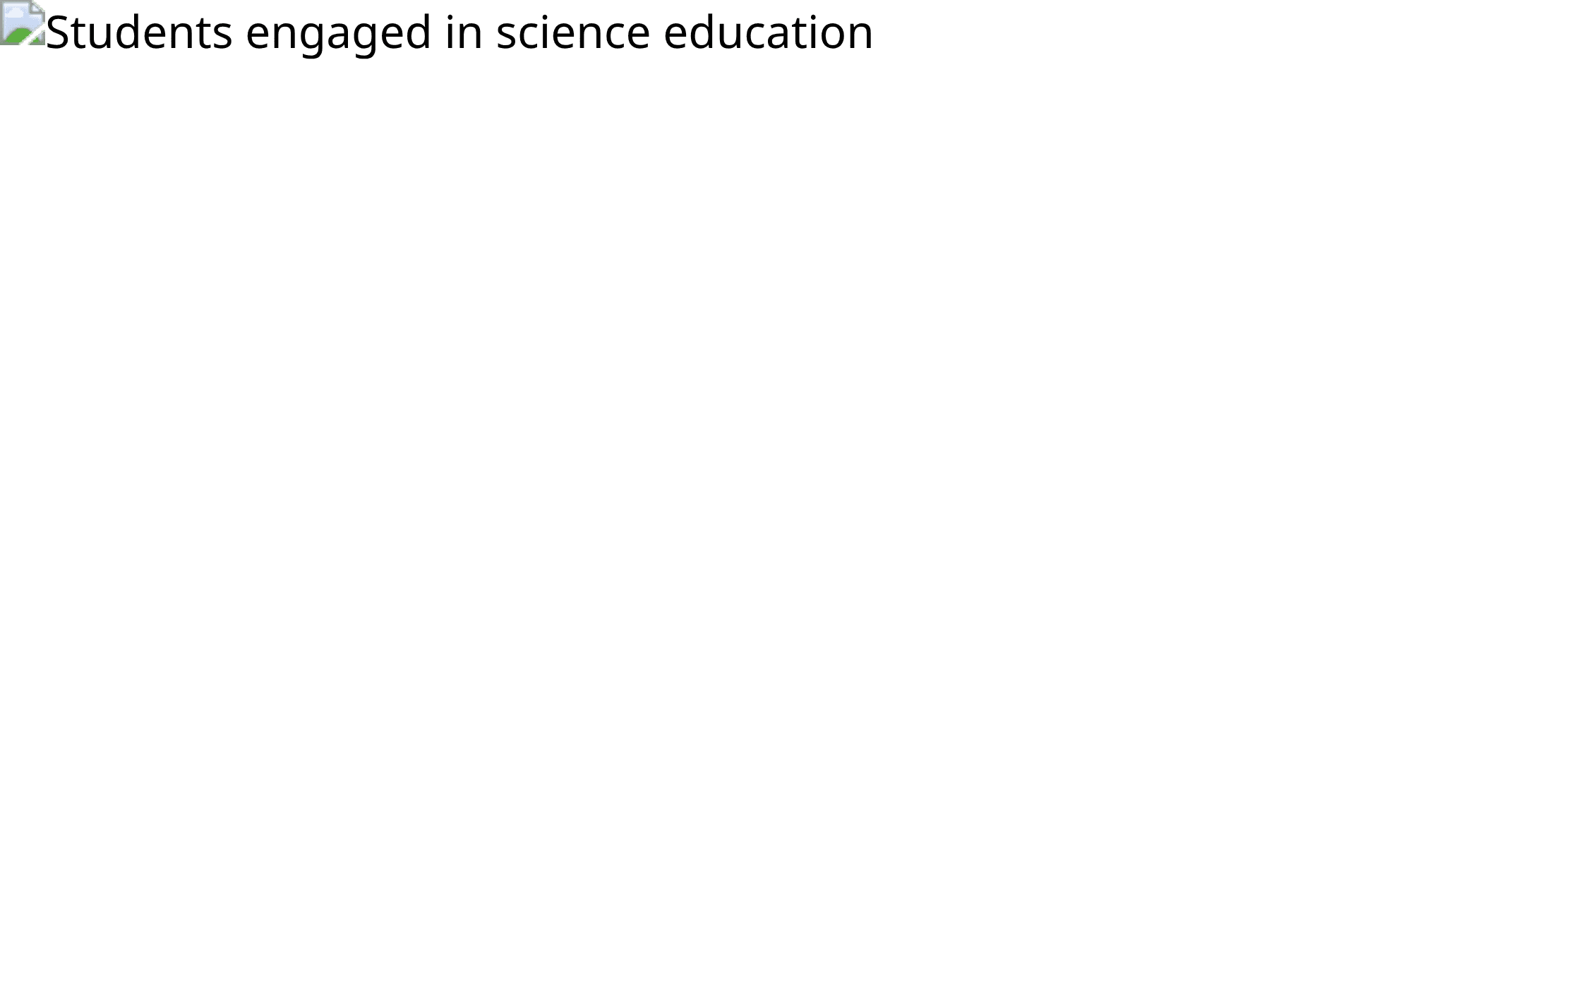
Communicating Data Results Effectively
Effective communication of data findings requires careful consideration of audience, appropriate visualization choices, and clear narrative structure that guides viewers from context through conclusions.
▸
Choose Appropriate Visualizations:
Select visualization types that match your data and audience. Different audiences (students, peers, public) may require different approaches.
▸
Clear Labeling and Legends:
All axes, variables, and symbols must be clearly labeled. Legends should explain colors, patterns, and symbols without ambiguity.
▸
Descriptive Captions:
Figures should include captions that explain what is shown, key findings, and units of measurement. Captions guide interpretation.
▸
Narrative Structure:
Present findings in logical order: context (why this matters), methods (how data were collected), results (what was found), implications (what it means).
▸
Avoid Misleading Representations:
Use consistent scales, avoid truncated axes, and don't distort proportions. Honest visualization builds trust and credibility.
Scientific Communication Standards
Peer review ensures quality and accuracy. Follow journal guidelines and disciplinary conventions. Transparency about methods and limitations strengthens scientific communication and enables reproducibility.

Slide 10

Ethical Considerations in Data Collection
Ethical responsibility is fundamental to scientific research. Scientists and educators must ensure that data collection practices respect human rights, protect privacy, maintain integrity, and contribute to the advancement of knowledge without causing harm.
Principle 1
Principle 2
Data Privacy and Protection
Informed Consent
Safeguard personal information and sensitive data from unauthorized access, loss, or misuse.
Ensure participants understand research purposes, methods, risks, and benefits before participating.
Key Practices
Key Practices
Use secure storage, encryption, anonymization, and access controls. Comply with data protection regulations (GDPR, HIPAA).
Provide clear information, allow voluntary participation, document consent, respect withdrawal rights.
Principle 3
Principle 4
Data Integrity and Honesty
Responsible Data Sharing
Maintain accuracy of data and prevent falsification, fabrication, or misrepresentation of results.
Promote open science while protecting sensitive information and respecting intellectual property rights.
Key Practices
Key Practices
Record data accurately, document methods, report all findings, acknowledge limitations and errors.
Share data through appropriate repositories, provide metadata, cite data sources, follow open science principles.
Principle 5
Bias Prevention and Transparency
Recognize and mitigate biases in data collection, analysis, and interpretation. Be transparent about methods and
limitations.
Key Practices
Use blinding when appropriate, document assumptions, report uncertainty, disclose conflicts of interest.
Ethical integrity in data collection and analysis is not merely a compliance requirement—it is the foundation upon which scientific credibility and public trust in research are built. Educators who model ethical practices instill these values in the next generation of scientists.

Slide 11

Practical Applications - Case Studies
Real-world applications: Data collection and analysis are not abstract concepts—they are essential practices in contemporary scientific research. The following case studies demonstrate how the techniques discussed in this chapter are applied to solve authentic scientific problems and advance human knowledge.
Case Study 1
Case Study 2
Case Study 3
Environmental Monitoring Using Sensor Networks
Medical Research Analyzing Patient Data
Climate Science Processing Satellite Data
Context
Context
Context
Environmental scientists deploy networks of sensors across ecosystems to
Medical researchers analyze large datasets containing patient
Climate scientists analyze satellite imagery and measurements to
continuously monitor temperature, humidity, soil moisture, air quality, and
demographics, medical histories, treatment outcomes, and biomarkers to
understand global climate patterns, track ice sheet changes, monitor sea
other parameters.
identify disease patterns and treatment effectiveness.
surface temperatures, and model future climate scenarios.
Data Collection
Data Collection
Data Collection
Wireless sensor networks transmit real-time data to central databases.
Electronic health records, laboratory tests, and clinical measurements
Earth observation satellites generate terabytes of data daily. Multiple
Sensors operate continuously, generating millions of measurements over
generate structured data. Privacy protections ensure patient confidentiality
sensors measure radiation, temperature, atmospheric composition, and
time.
through anonymization and secure storage.
surface characteristics across the globe.
Analysis Approach
Analysis Approach
Analysis Approach
Time-series analysis reveals seasonal patterns. Statistical methods identify
Descriptive statistics characterize patient populations. Correlation analysis
Image processing extracts climate variables. Time-series analysis reveals
anomalies indicating ecosystem stress. Visualization shows spatial
identifies risk factors. Regression models predict treatment outcomes.
long-term trends. Statistical models quantify uncertainty. Visualization
distribution of environmental conditions.
Hypothesis testing validates clinical hypotheses.
communicates findings to policymakers.
Impact
Impact
Impact
Enables early detection of environmental changes, supports conservation
Leads to personalized medicine, improved treatment protocols, and
Provides critical evidence for climate change, informs environmental
decisions, and provides evidence for climate change impacts.
evidence-based clinical decisions that save lives.
policy, and guides international climate agreements.
These case studies illustrate that data collection and analysis are not isolated technical skills—they are fundamental practices that connect scientific inquiry to real-world problem-solving, enabling researchers to generate evidence, test hypotheses, and contribute meaningfully to scientific advancement and societal benefit.

Slide 12

From Data to Discovery
Key Takeaway 1
Key Takeaway 2
Data Collection is Foundational to Science
Visualization Reveals Hidden Patterns
Modern science depends on accurate, systematic data collection using sensors and digital tools. Understanding data acquisition systems is essential for educators preparing students for contemporary scientific research.
Transforming raw data into visual representations makes patterns, trends, and relationships apparent. Effective visualization is both an analytical tool and a communication strategy for sharing scientific findings.
Key Takeaway 3
Key Takeaway 4
Statistical Analysis Quantifies Uncertainty
Ethical Practices Ensure Scientific Integrity
Statistical methods provide rigorous, quantifiable evidence that distinguishes genuine patterns from random variation. Proper statistical analysis ensures scientific conclusions are reliable and defensible.
Responsible data collection, analysis, and communication are fundamental to scientific ethics. Educators must model and teach ethical practices to prepare students as responsible scientists.
Educational Impact
By teaching data collection, visualization, and analysis skills, educators empower students to engage with real scientific data, develop critical thinking abilities, and understand how modern science actually works. These competencies prepare students for careers in science, technology, and data-driven fields.
Looking Ahead
In Chapter 6, we will explore how to apply computational tools to:
Scientific Modeling and Simulation

